Slide 1
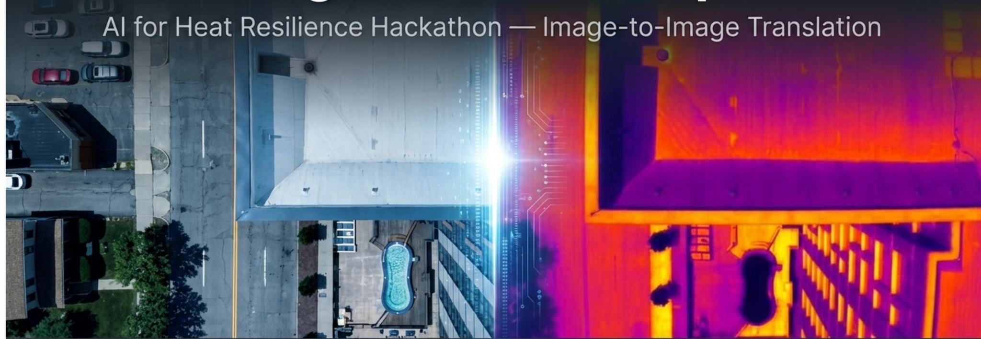
Team: Game of Drones
Galgallo, Adithya, Santosh, Nima

Slide 2
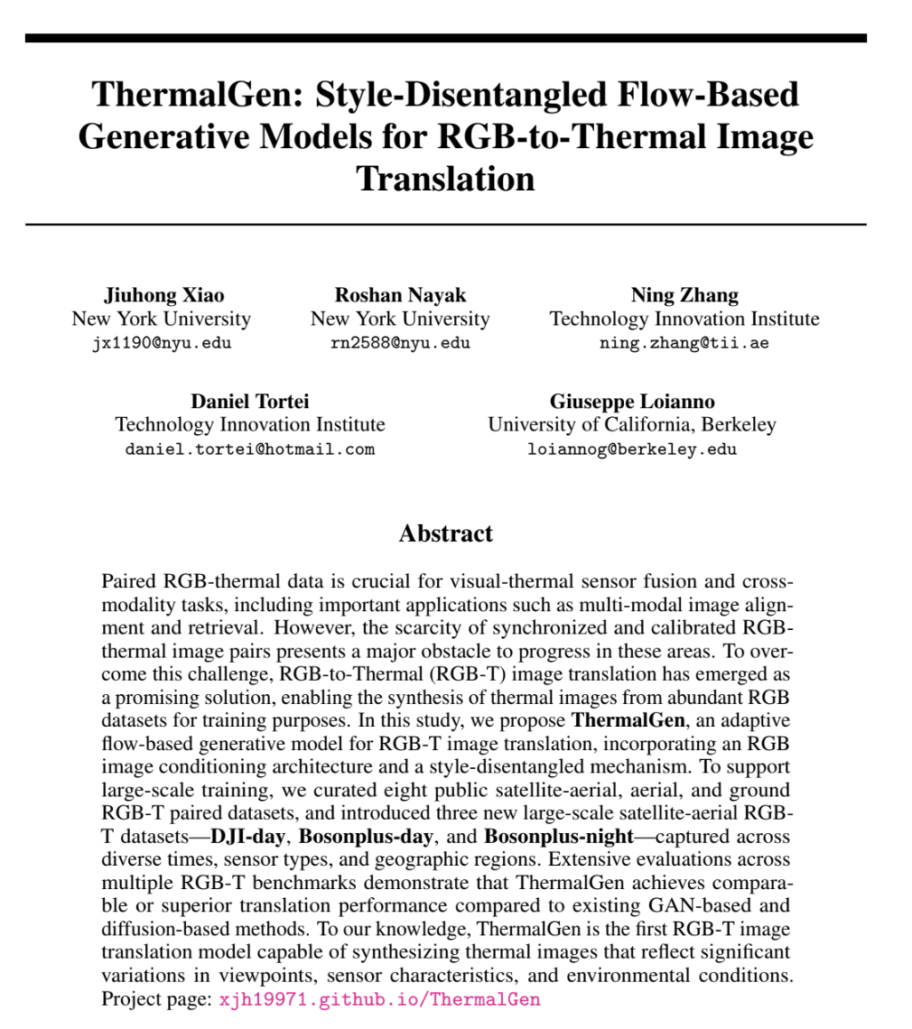
ThermalGen: Model Overview
Architecture
Flow-based generative model using SiT (Scalable Interpolant Transformers)
RGB image conditioning via cross-attention mechanism
Style-disentangled embeddings enable multi-dataset training
adaLN-Zero conditioning with dataset-specific and unconditional style embeddings
ODE sampler for high-fidelity thermal image generation
Source: github.com/arplaboratory/ThermalGen | HuggingFace: xjh19972

Slide 3
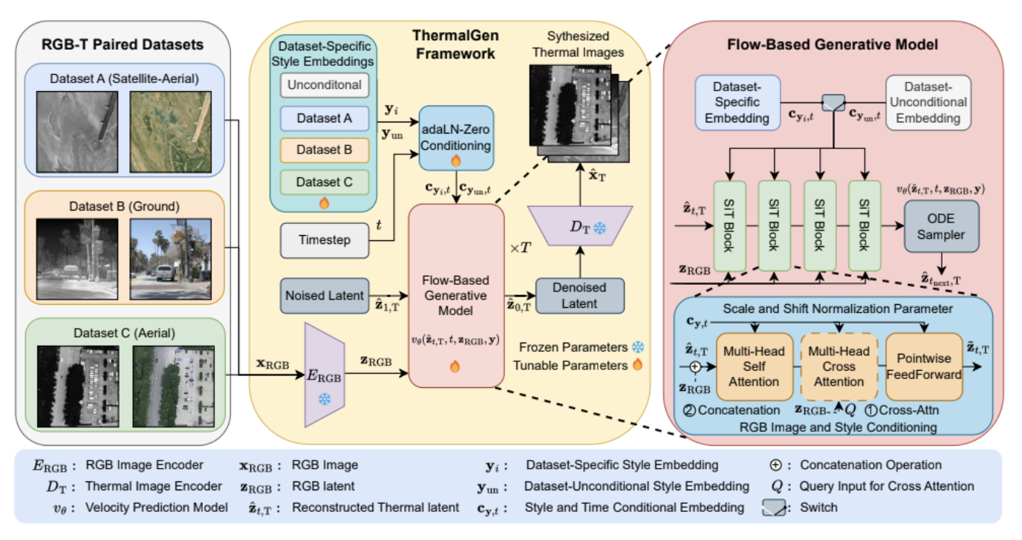
ThermalGen: Model Overview
How we used the baseline
Load a pre trained ThermalGen checkpoint.
Resize RGB inputs to 256 × 256 and normalize them to [-1, 1].
Run inference with a fixed dataset_idx = 1000.
Convert predictions back from [-1, 1] to [0, 1].
Compare predicted thermal output against the paired thermal ground truth.
Compute PSNR, SSIM, and LPIPS for each image, then average across the sample set.
Source: github.com/arplaboratory/ThermalGen | HuggingFace: xjh19972

Slide 4
Notebook 2: ThermalGen-XL-2 — Unconditional
Model: XL-2 | Style: Unconditional (idx=1000) | 8 test pairs from custom Heat Resilience dataset
Sample | PSNR ↑ | SSIM ↑ | LPIPS ↓
0.JPG | 6.9005 | 0.1962 | 0.6668
1.JPG | 7.6392 | 0.1674 | 0.5689
107.JPG | 8.7633 | 0.2694 | 0.6066
112.JPG | 6.9450 | 0.2900 | 0.7145
114.JPG | 6.1177 | 0.2061 | 0.6262
115.JPG | 4.7904 | 0.2343 | 0.6830
118.JPG | 8.3146 | 0.2214 | 0.5827
120.JPG | 5.1526 | 0.2308 | 0.6524
Mean | 6.828 | 0.227 | 0.638
6.83
PSNR
Peak Signal-to-Noise Ratio
0.227
SSIM
Structural Similarity
0.638
LPIPS
Perceptual Distance

Slide 5
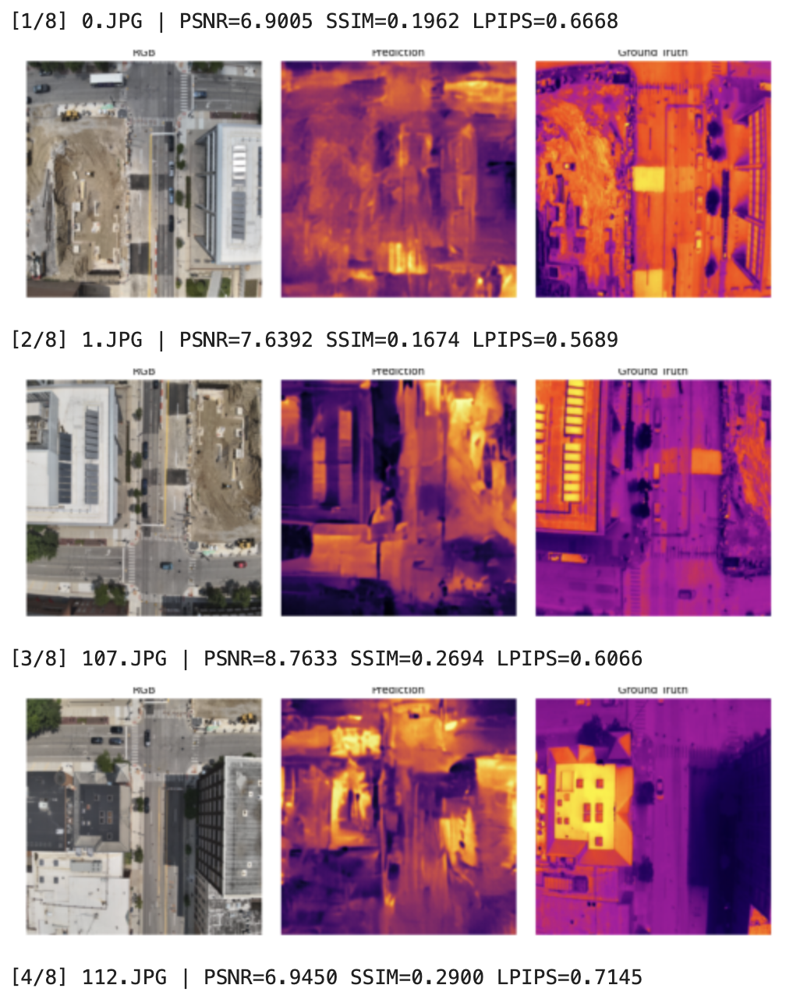
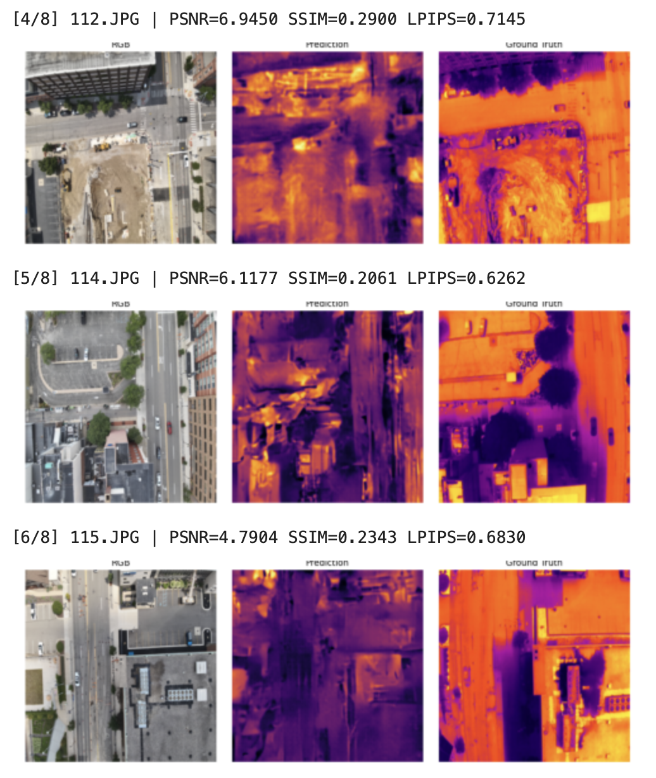

Slide 6
Notebook 3: ThermalGen-L-2-concat — Unconditional
Model: L-2-concat | Style: Unconditional (idx=1000) | 6 test pairs from custom Heat Resilience dataset
Sample | PSNR ↑ | SSIM ↑ | LPIPS ↓
0.JPG | 7.3550 | 0.2197 | 0.6270
1.JPG | 9.6178 | 0.2077 | 0.5714
5.JPG | 8.0134 | 0.4112 | 0.7231
57.JPG | 3.5369 | 0.1748 | 0.7129
58.JPG | 7.6154 | 0.2286 | 0.6420
62.JPG | 9.5432 | 0.2899 | 0.5396
Mean | 7.614 | 0.255 | 0.636
7.61
PSNR
Peak Signal-to-Noise Ratio
0.255
SSIM
Structural Similarity
0.636
LPIPS
The main architectural difference is how RGB information is injected. In the concat model, RGB features are directly appended to the latent representation, which makes conditioning simpler and, in the paper’s ablations, more effective than cross-attention.
Perceptual Distance

Slide 7
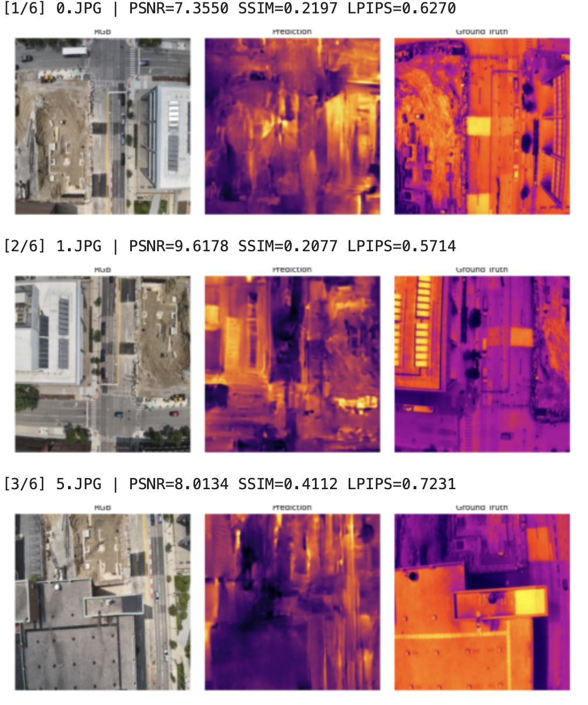
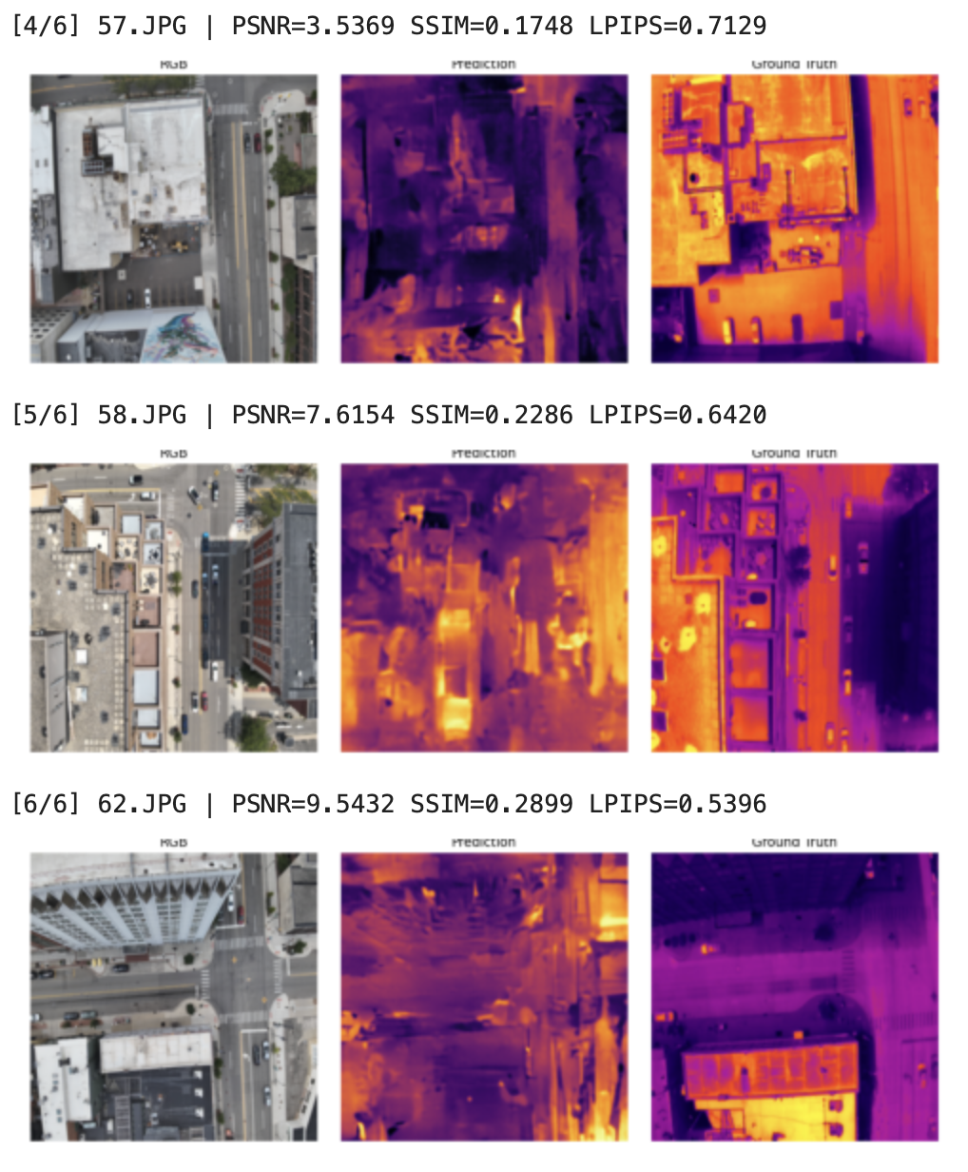

Slide 8
Notebook 4: Style Embedding — DJI-day (idx=3)
Model: L-2-concat | Style: DJI-day (dataset_idx=3) | 6 test pairs — exploring dataset-specific style conditioning
Sample | PSNR ↑ | SSIM ↑ | LPIPS ↓
0.JPG | 6.0508 | 0.1309 | 0.5912
1.JPG | 8.6858 | 0.1661 | 0.5698
5.JPG | 6.0806 | 0.2375 | 0.6736
57.JPG | 5.6698 | 0.2016 | 0.6981
58.JPG | 6.9923 | 0.1678 | 0.6073
62.JPG | 10.9044 | 0.2375 | 0.5084
Mean | 7.397 | 0.190 | 0.608
7.40
PSNR
Peak Signal-to-Noise Ratio
0.190
SSIM
Structural Similarity
0.608
LPIPS
Perceptual Distance (best)
Style embedding insight: DJI-day style achieves the best LPIPS (0.608) among baseline runs, indicating better perceptual quality, even though pixel-level PSNR/SSIM are slightly lower. This suggests style conditioning helps produce more realistic-looking thermal patterns.

Slide 9





Pipeline v2: Refinement U-Net Architecture
Multi-Input Refinement Network
Architecture Details
A lightweight U-Net (4.35M params) that refines ThermalGen baseline predictions by incorporating additional contextual signals. The model learns residuals on top of inferno-color mapped baseline outputs.
Encoder: 3 conv blocks (48→96→192 channels) with max-pooling
Bottleneck: 384-channel conv block
Decoder: 3 upsampling blocks with skip connections
Condition Injector MLPs for weather (8→4) and AlphaEarth (64→8) features spatially broadcast
Output: residual + inferno baseline, clamped to [0,1]
Loss: L1 + 0.2 × MSE
Optimizer: AdamW (lr=5e-4) + Cosine Annealing
Training: 100 epochs, batch_size=4, early stopping (patience=15)
RGB Image
3 ch
ThermalGen Pred
1 ch
Inferno Colormap
3 ch
Weather Data
4 ch
AlphaEarth Embed.
8 ch
GPU: NVIDIA RTX A6000 | Dataset: 418 train (377/41 split), 202 test
Total: 19 input channels

Slide 10
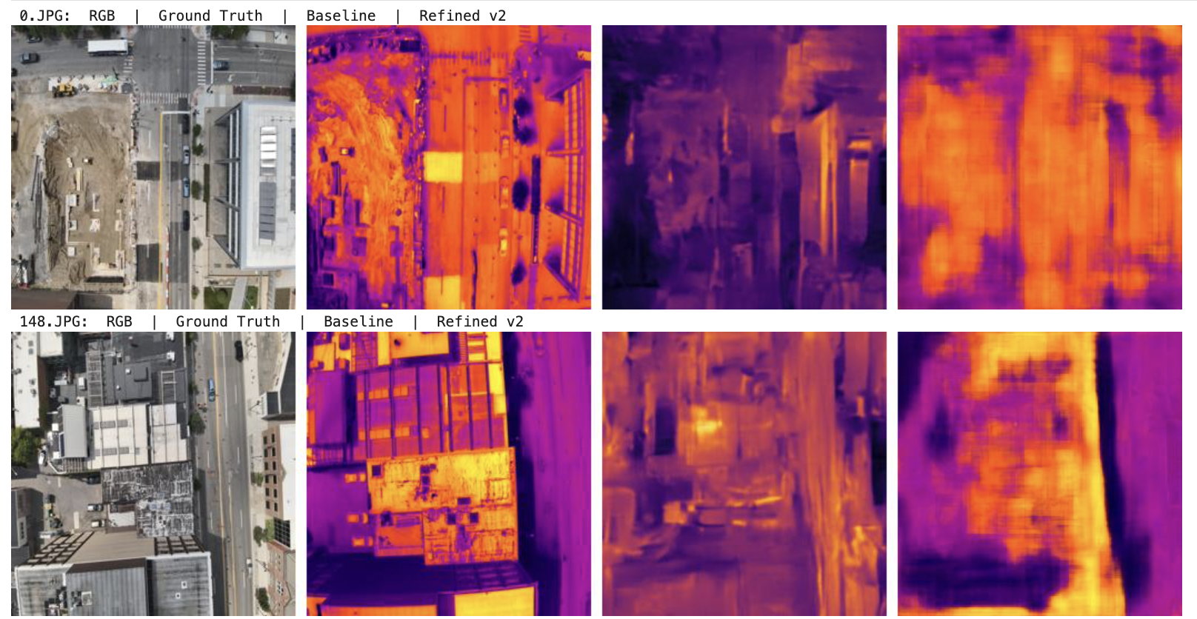
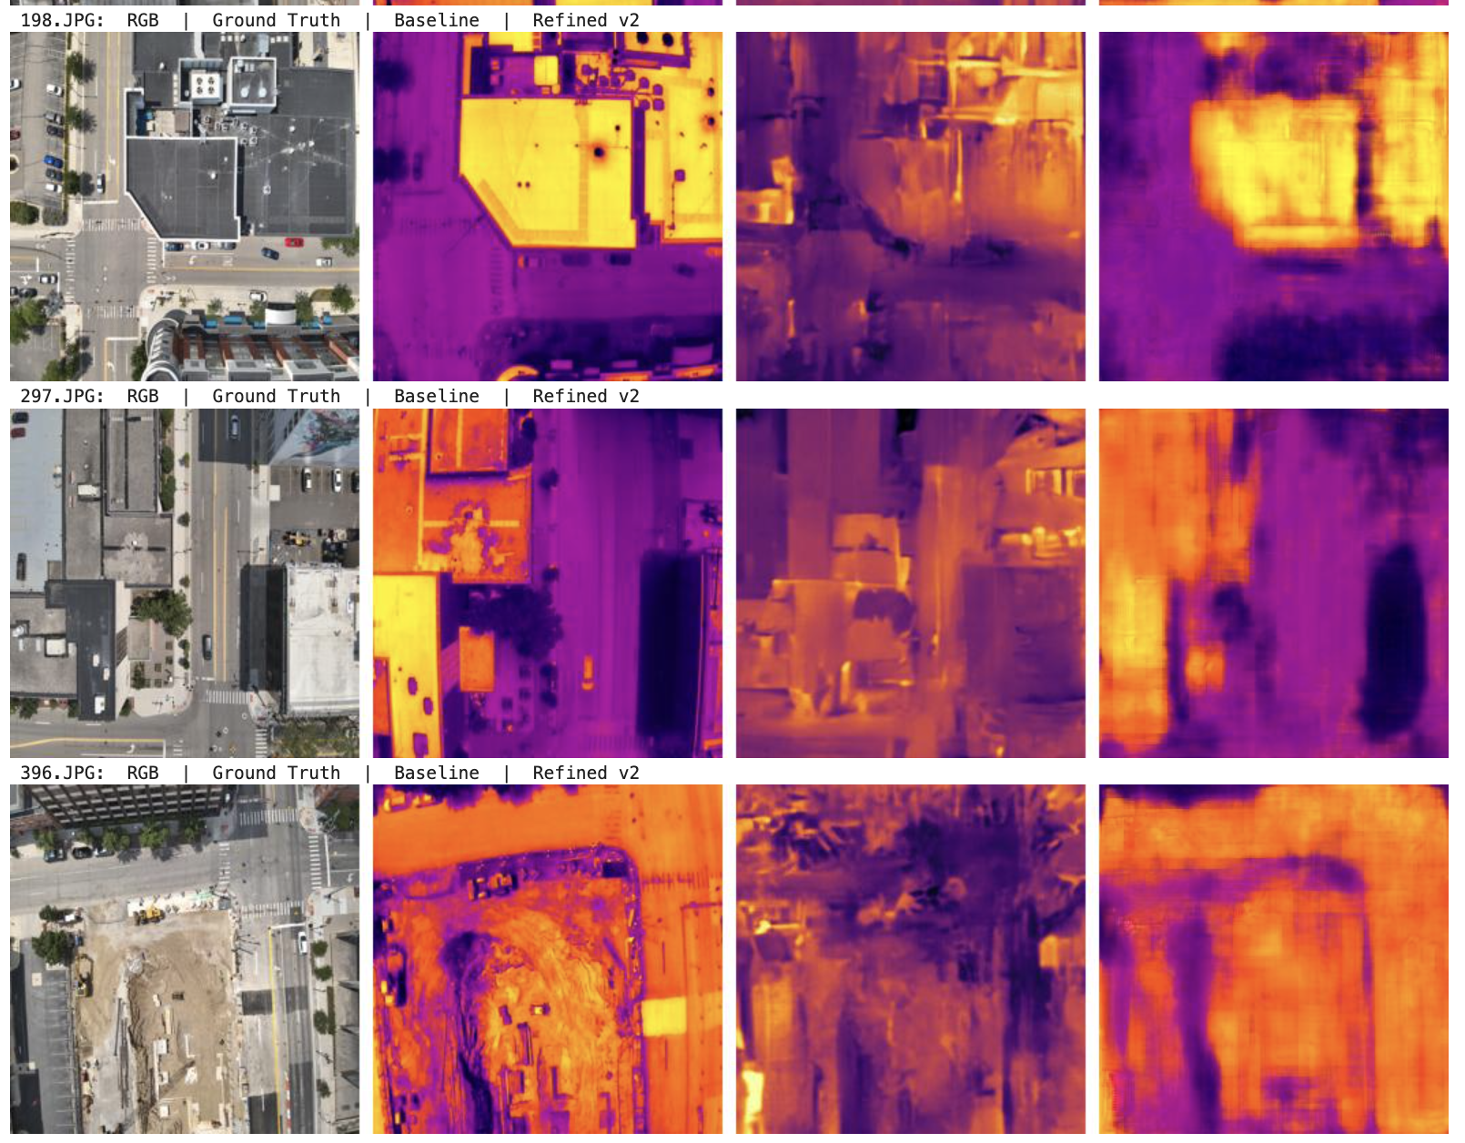
Refinement Results

Slide 11
Refinement Results: Full Scoreboard
Metric | Baseline | Refined v2 | Change
PSNR ↑ | 10.327 | 16.751 | +6.424
SSIM ↑ | 0.1478 | 0.4485 | +0.3007
LPIPS ↓ | 0.5699 | 0.4080 | −0.1619
+62%
3×
−28%
PSNR Improvement
10.3 → 16.8 dB
SSIM Improvement
0.15 → 0.45
LPIPS Reduction
0.57 → 0.41
Evaluation on full 418-image training set | Val PSNR reached 14.30 dB

Slide 12
ResNet Refinement with FiLM Conditioning
Two-stage pipeline: ThermalGen generates a rough thermal → ResNet18 refines it using weather + satellite metadata
How It Works
Key Design Choices
Stage 1 — ThermalGen (frozen, pretrained)
FiLM Conditioning at Every Decoder Layer
A NeurIPS diffusion model takes your RGB aerial image and produces a rough 256×256 thermal prediction. We tested 15+ style settings and found style index 14 gives the best free gain (+1.44 dB) — no training needed.
A 71-dim vector (7 weather features + 64 AlphaEarth satellite embeddings) is injected into every decoder layer via Feature-wise Linear Modulation. Metadata literally tunes how the network reads each feature map.
Stage 2 — ResNetThermalNet (our trained model)
Transfer Learning from ImageNet
ResNet18 encoder (ImageNet-pretrained) + U-Net decoder. Takes the rough thermal + original RGB + a 71-dim metadata vector → outputs a refined single-channel grayscale thermal image.
ResNet18 already knows how to recognize roofs, trees, and roads from natural images. Early layers are frozen; later layers fine-tune to the thermal domain — faster convergence with less data.
Post-processing
Grayscale Output (1 channel)
Test-Time Augmentation (TTA) averages 4 flipped versions of each prediction. Then bicubic upsampling brings the output from 256×256 → 640×512 to match ground-truth resolution.
Competition judges evaluate on single-channel thermal. Predicting 1 pixel value instead of 3 gives the loss a cleaner, more focused signal — and directly matches the target format.
Multi-Objective Loss: L1 + SSIM + LPIPS
Loss = 0.4×L1 + 0.3×(1−SSIM) + 0.3×LPIPS. Each term directly targets one of the three judging metrics, so the model optimizes for exactly what the leaderboard measures.
14.5M total params | 418 train images (377/41 split) | GPU: NVIDIA RTX A6000

Slide 13
Results: ResNet Refinement Scoreboard
Evaluated on 41-image validation set | Best checkpoint: epoch 58
Metric | ThermalGen Baseline | Our ResNet Model | Improvement
PSNR ↑ | 12.83 dB | 17.43 dB | +4.60 dB (+36%)
SSIM ↑ | ~0.20 | 0.430 | +0.23 (2.2×)
LPIPS ↓ | ~0.57 | 0.392 | −0.18 (−31%)
17.43
PSNR (dB)
Val set — 41 images
0.430
SSIM
Structural Similarity
+36%
2.2×
−31%
0.392
LPIPS
PSNR Improvement
12.83 → 17.43 dB
SSIM Improvement
0.20 → 0.43
LPIPS Reduction
0.57 → 0.39
Perceptual Distance
Why These Numbers Matter
PSNR +36% = pixels are dramatically more accurate — less noise, sharper boundaries. SSIM 2.2× = structure (rooftops, roads) is preserved far better. LPIPS −31% = the output looks perceptually closer to a real thermal camera.
Loss: 0.4×L1 + 0.3×(1−SSIM) + 0.3×LPIPS | TTA: 4-way flip averaging | 202 test predictions submitted

Slide 14
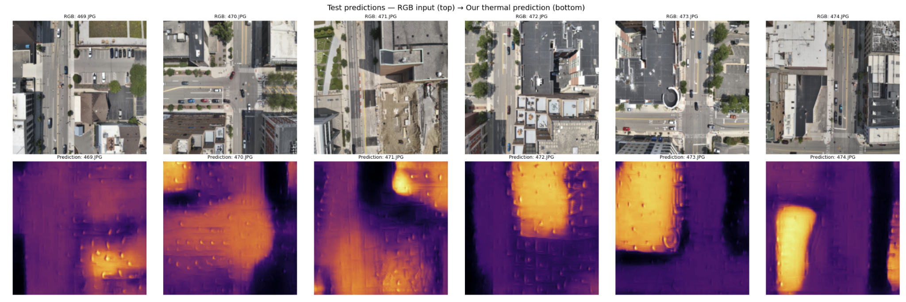
Visual Results: RGB → Refined Thermal Prediction
Test Set Sample Gallery | RGB input (top) → Our refined thermal prediction (bottom)
What the model captures
Submission Details
Hot surfaces (rooftops, asphalt, sun-facing walls) appear bright
Cool areas (trees, shadows, open sky) rendered dark and distinct
Building footprints and road edges are spatially aligned with RGB
Relative temperature gradients across urban materials are consistent
202 test predictions generated with TTA (4-flip averaging)
Output: grayscale 640×512 — matches competition ground-truth resolution
Val PSNR: 17.43 dB — best of all approaches we tested this hackathon
Metadata fusion (weather + AlphaEarth) gave ~2 dB over RGB-only baseline
17.43 PSNR
0.430 SSIM
0.392 LPIPS
↓ Insert your RGB → Prediction side-by-side comparison image here ↓
(Image from Notebook 4 — test predictions panel)

Slide 15
End-to-End: ThermalGenWithAlphaEarth
A fine-tuned ThermalGen model with native AlphaEarth satellite embedding fusion — trained and evaluated on the aligned split manifest
Model Configuration
Test Split Results (44 samples)
Model: ThermalGenWithAlphaEarth (concat fusion)
AlphaEarth encoder: 64 channels, 512 latent dim
Style embeddings + spatial AlphaEarth features
Trained on aligned split: 199 train / 42 val / 44 test
Best checkpoint: epoch 33 (best_psnr.pth)
Train loss: 0.2876 | Val loss: 0.3062
Val PSNR: 13.69 dB | Val SSIM: 0.042
14.49
PSNR
± 1.69 std dev
Peak Signal-to-Noise Ratio on held-out test set
0.039
SSIM
± 0.031 std dev
Low SSIM suggests structural misalignment — room for further tuning
This end-to-end approach achieves strong PSNR (14.49) on the test split without a separate refinement stage, demonstrating that native AlphaEarth fusion within ThermalGen is a promising direction. SSIM remains low, suggesting the model captures intensity patterns but not fine structural detail.

Slide 16
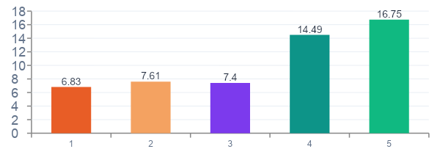
All Approaches: Comparison Summary
Approach | PSNR ↑ | SSIM ↑ | LPIPS ↓ | Eval Set
XL-2 (unconditional) | 6.83 | 0.227 | 0.638 | 8 pairs
L-2-concat (unconditional) | 7.61 | 0.255 | 0.636 | 6 pairs
L-2-concat (DJI-day style) | 7.40 | 0.190 | 0.608 | 6 pairs
ThermalGenWithAlphaEarth | 14.49 | 0.039 | — | 44 test
Refinement U-Net v2 | 16.75 | 0.449 | 0.408 | 418 train
Progression
Baseline models: PSNR ~6.8–7.6 on small test sets
AlphaEarth E2E: 14.49 PSNR — strong pixel accuracy but low SSIM
Refinement U-Net v2: 16.75 PSNR + 0.45 SSIM + 0.41 LPIPS — best overall quality
Multi-signal fusion (weather + AlphaEarth + baseline) proves most effective

Slide 17



Limitations & Challenges
1. Data Loss During Preprocessing
Training samples lost during dataset transfer (zipping/downloading from Drive)
Expected: 468 RGB + 468 Thermal | Actual: 418 RGB + 468 Thermal — imbalanced dataset
2. Limited Training Data (Core Problem)
RGB-Thermal paired datasets are inherently scarce and expensive to collect
Smaller dataset → weaker generalization, risk of overfitting, struggles with edge cases
3. Time Constraints (Hackathon Setting)
Could not train from scratch — relied on fine-tuning pretrained ThermalGen
Limited ability to optimize architecture, tune hyperparameters, or run large-scale experiments

Slide 18


Limitations & Challenges
4. AlphaEarth Embedding Limitation
AlphaEarth embeddings are static (precomputed) — not updated during training
No task-specific adaptation → may not capture local heat variations or building-level thermal behavior
Limits the model’s ability to learn dynamic or context-specific features
5. Cross-Modal Learning Difficulty
RGB images do not directly contain thermal information — model must infer heat patterns from visual cues
Inherently uncertain, leading to errors in material-based heat differences and hidden heat sources

